Slide 1
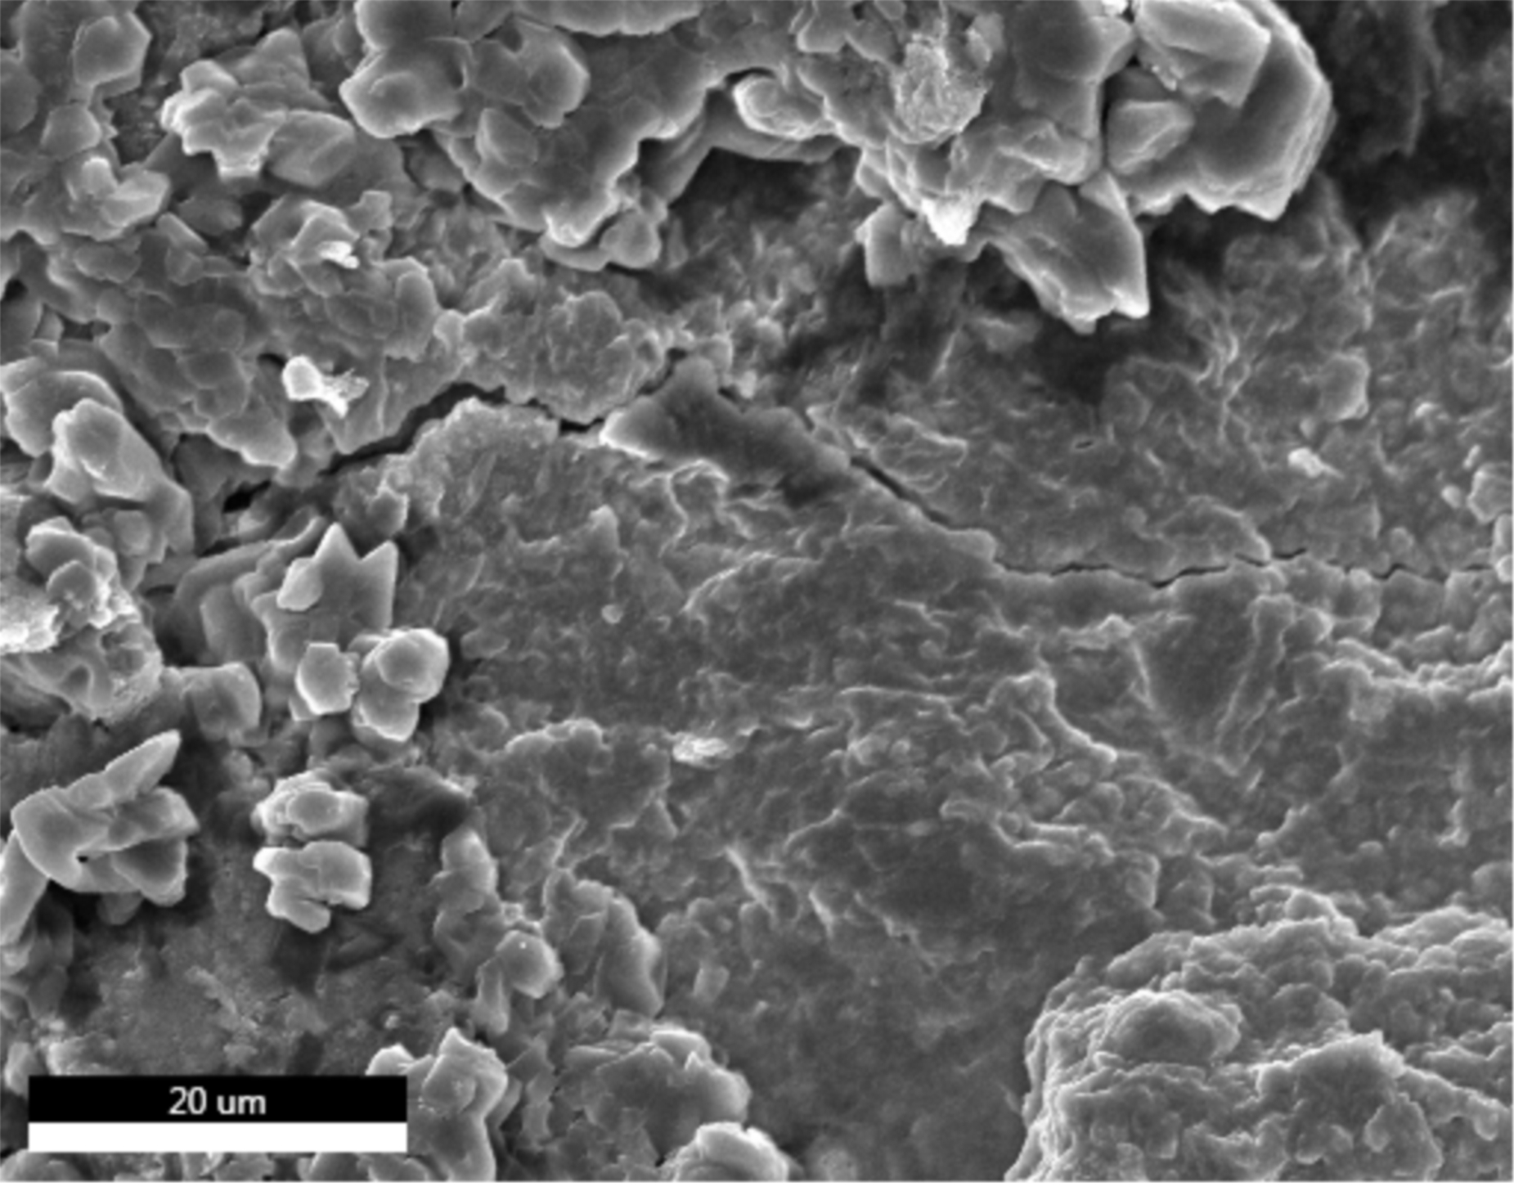
EDAX TEAM
Page
1
MDB Flake - Cycled
Author:
Bleifer
Creation:
07/07/2023 1:54:54 PM
Sample Name:
G
Area 1
Live Map 1
Image

Slide 2
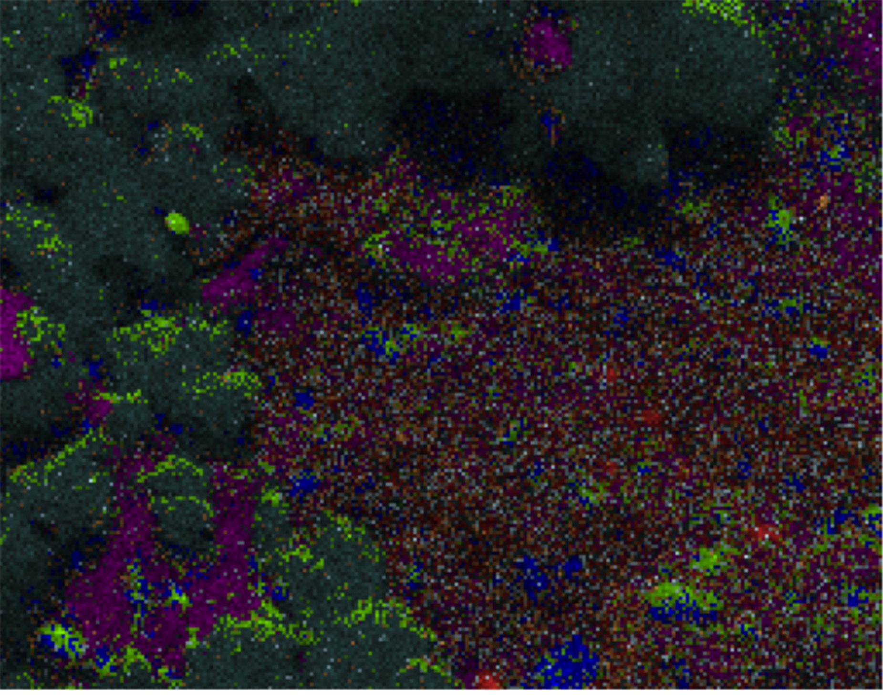
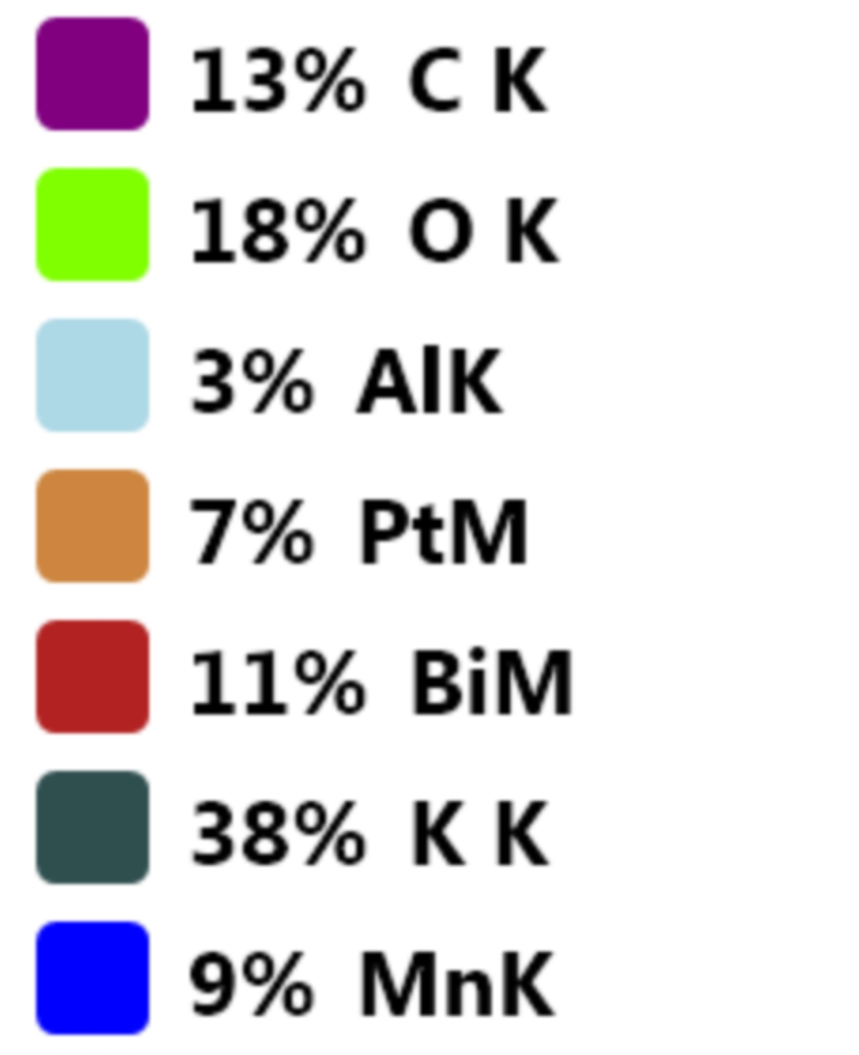
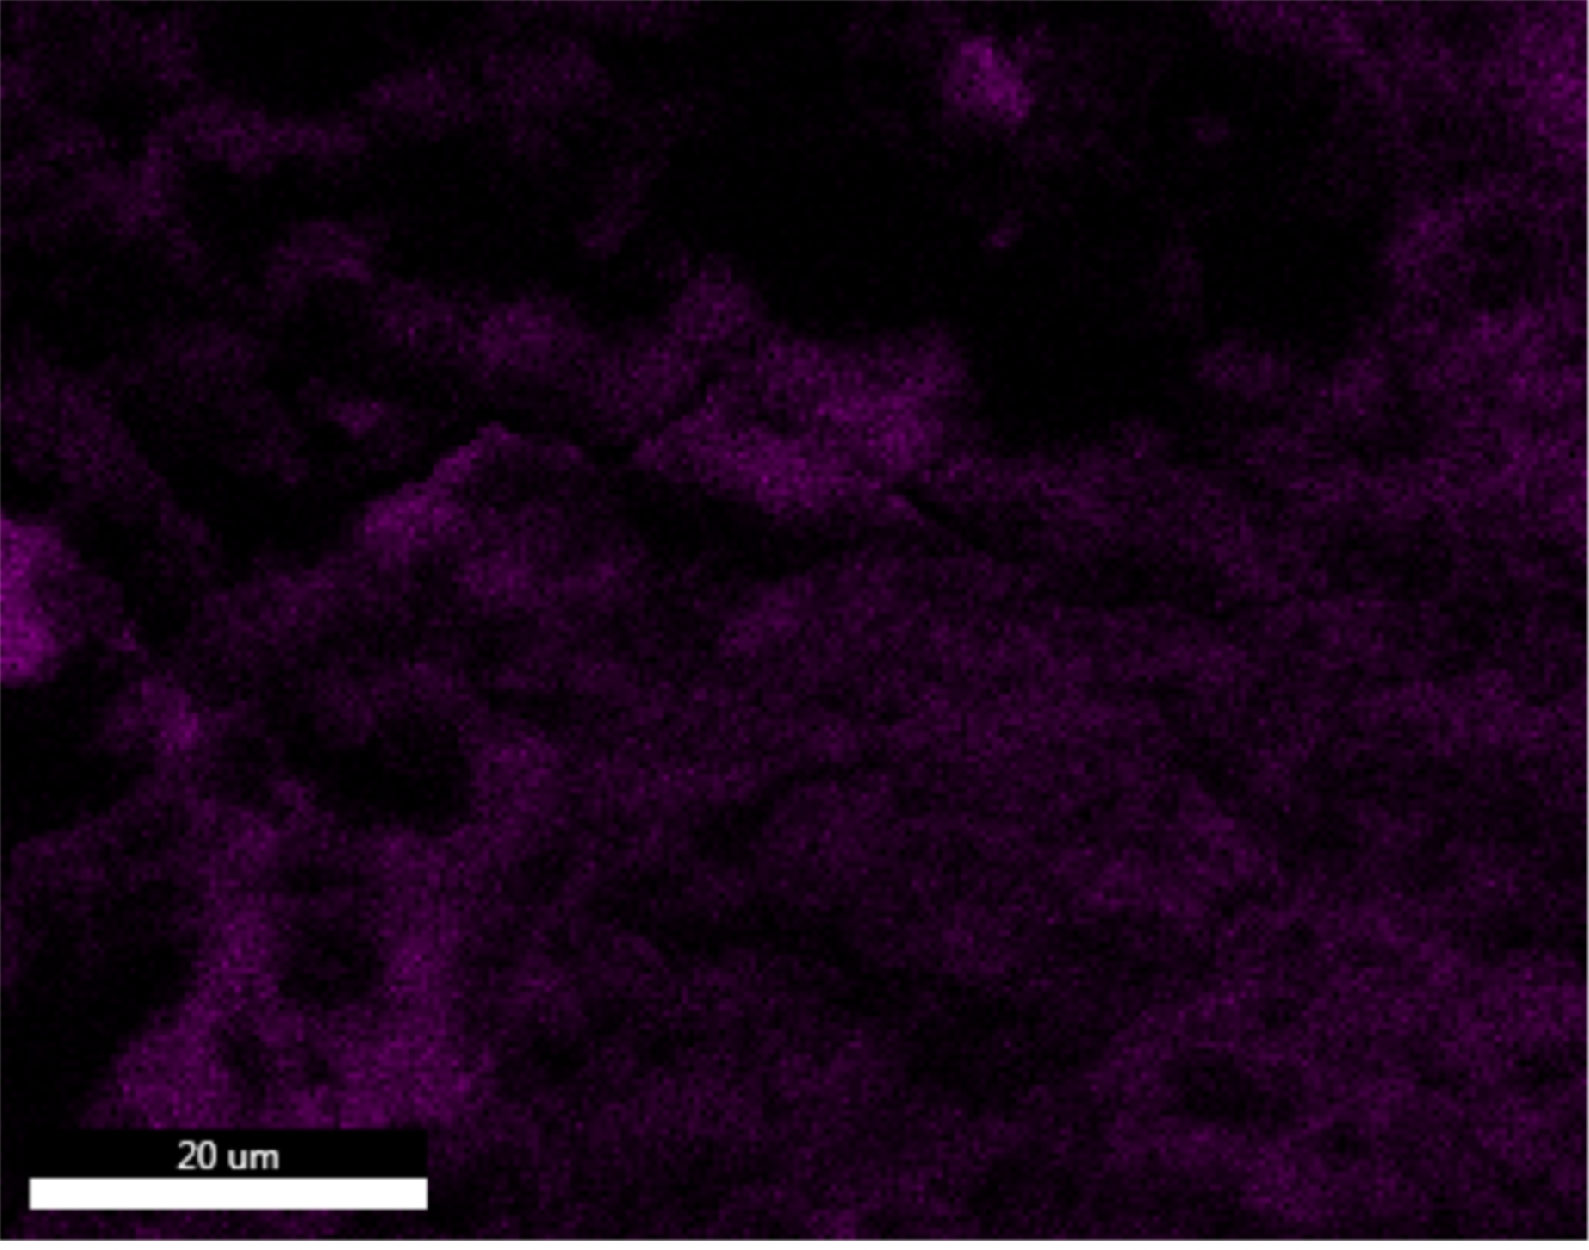
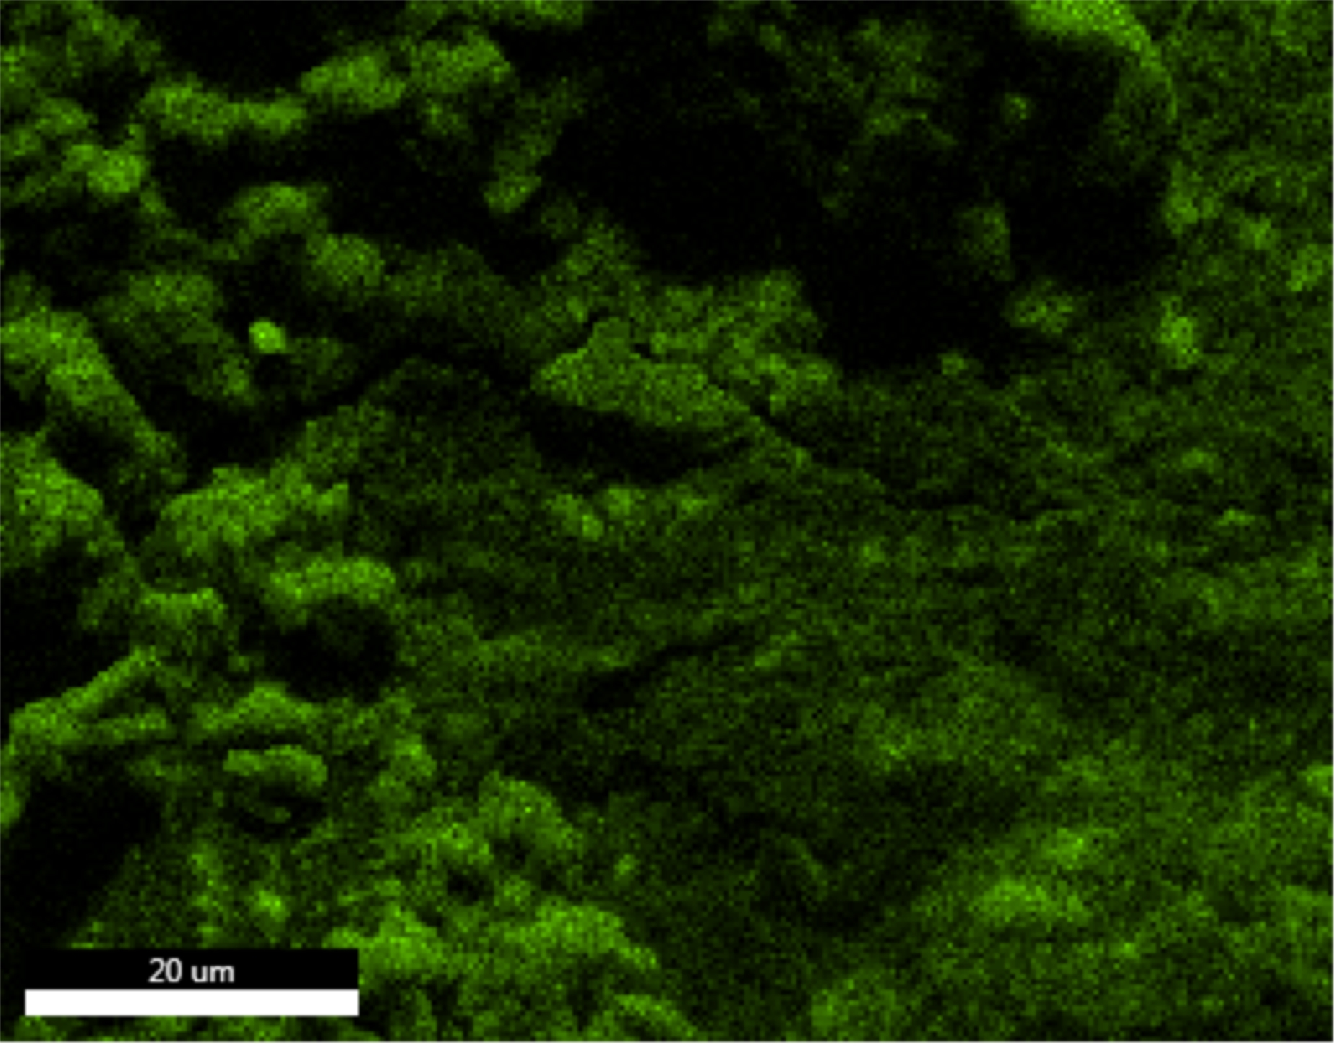
EDAX TEAM
Page
2
ElementOverlay
C K_ROI (38)
O K_ROI (58)

Slide 3
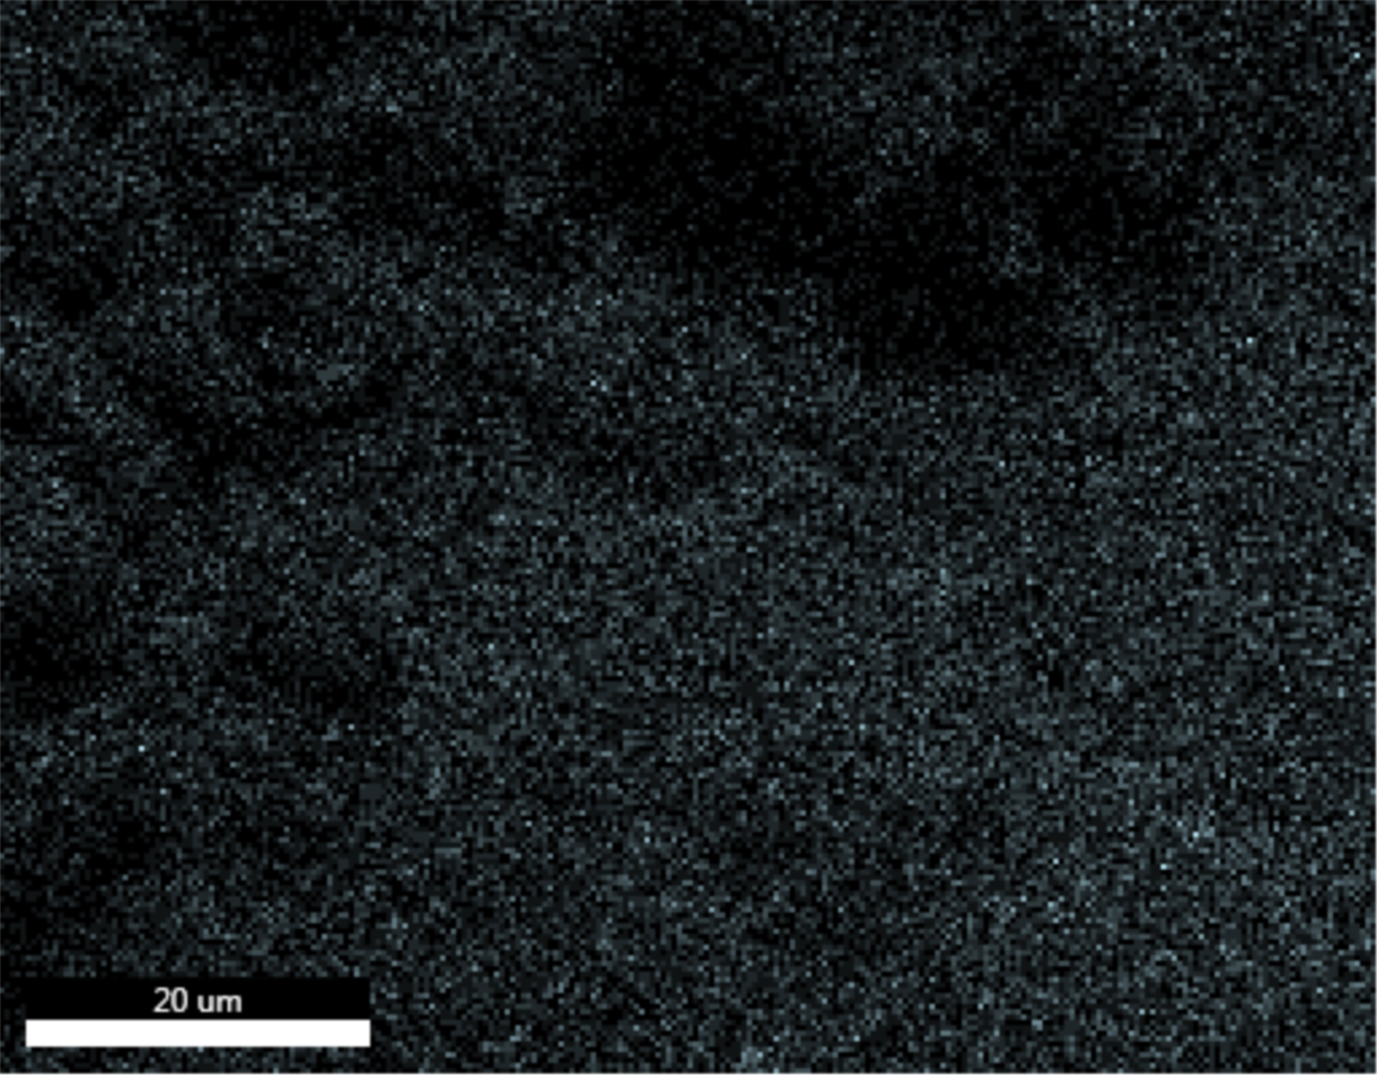
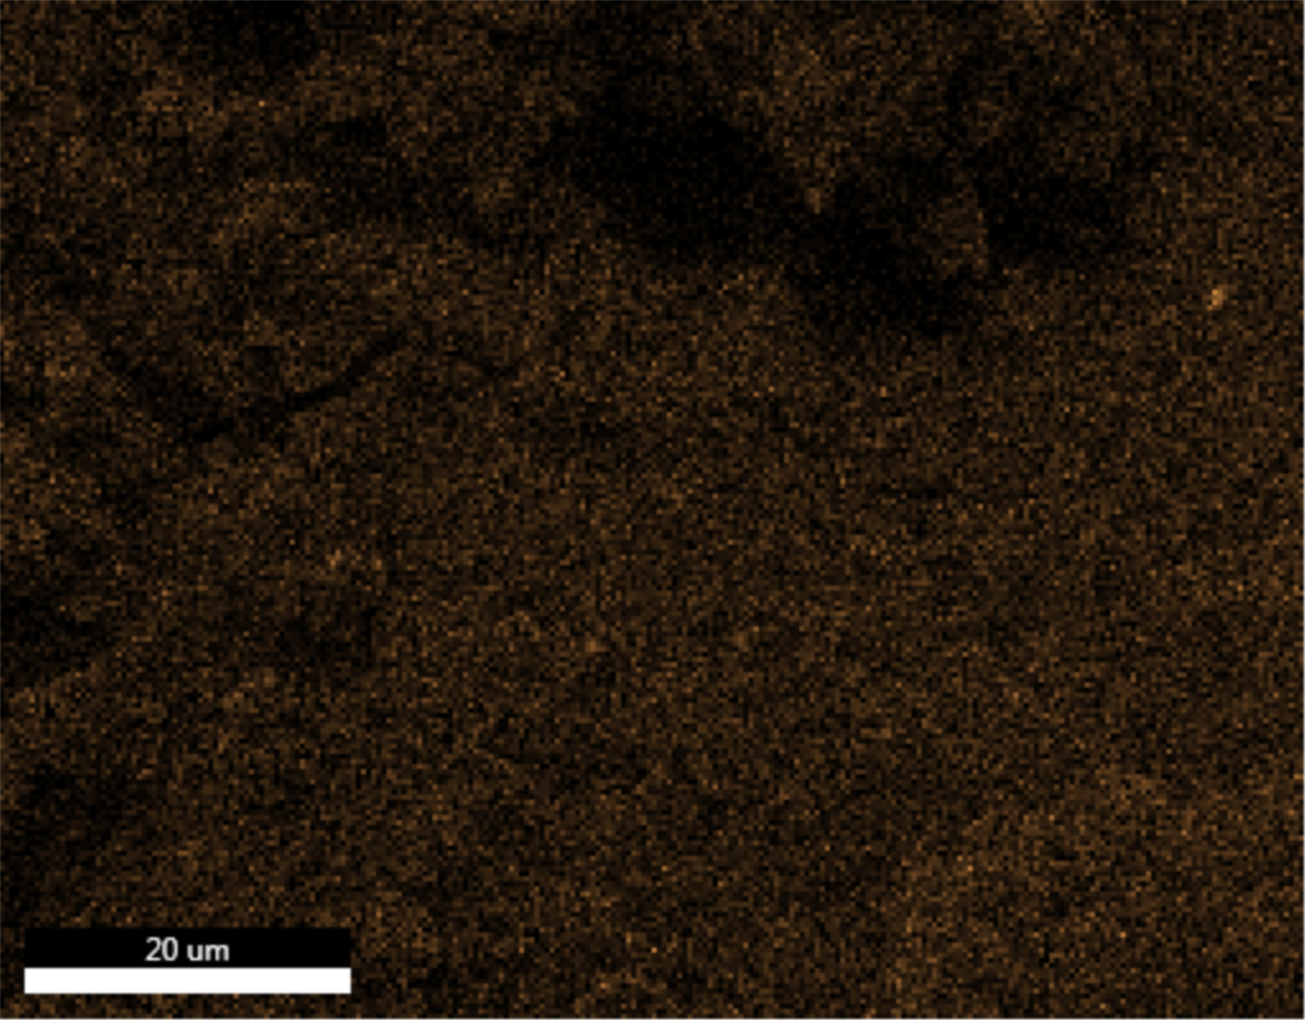
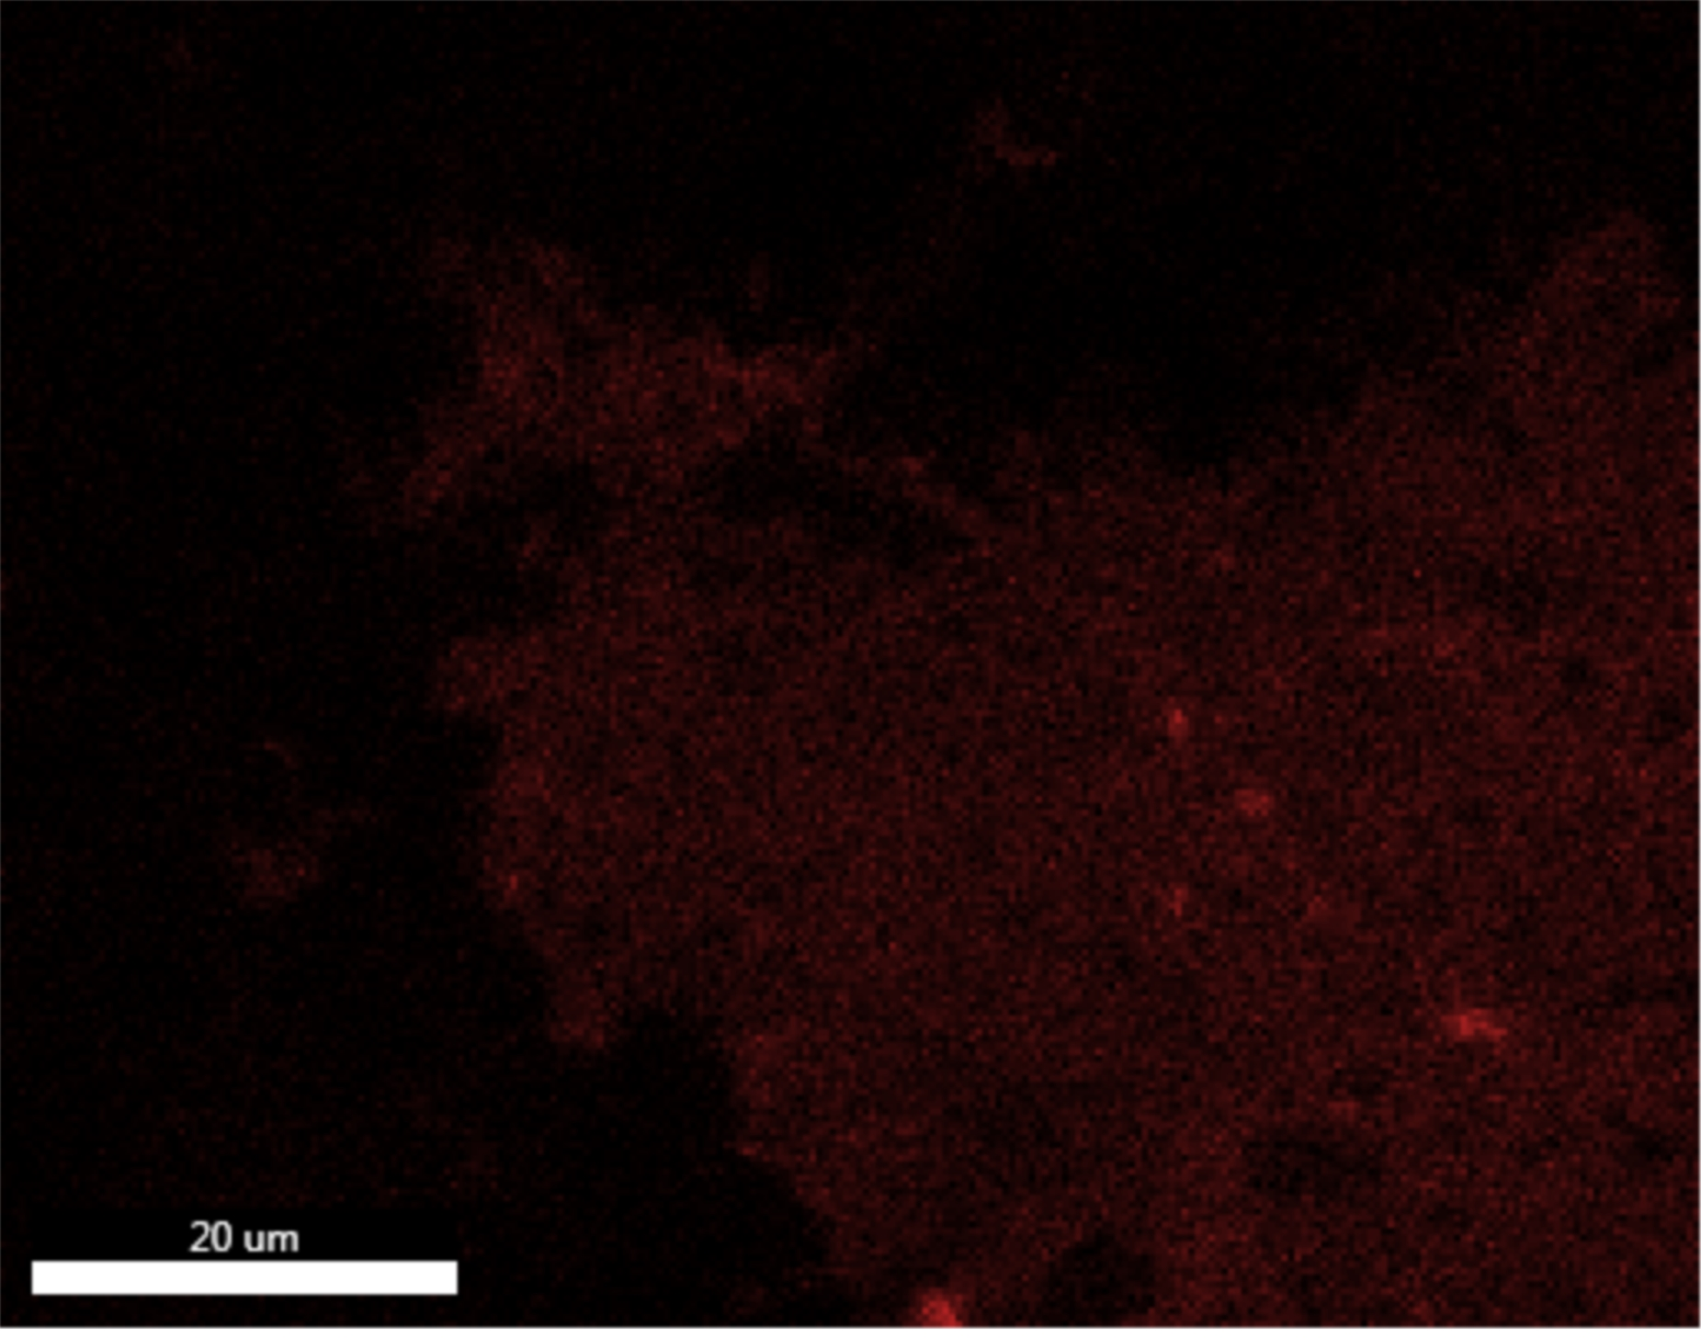
EDAX TEAM
Page
3
AlK_ROI (11)
PtM_ROI (20)
BiM_ROI (45)

Slide 4
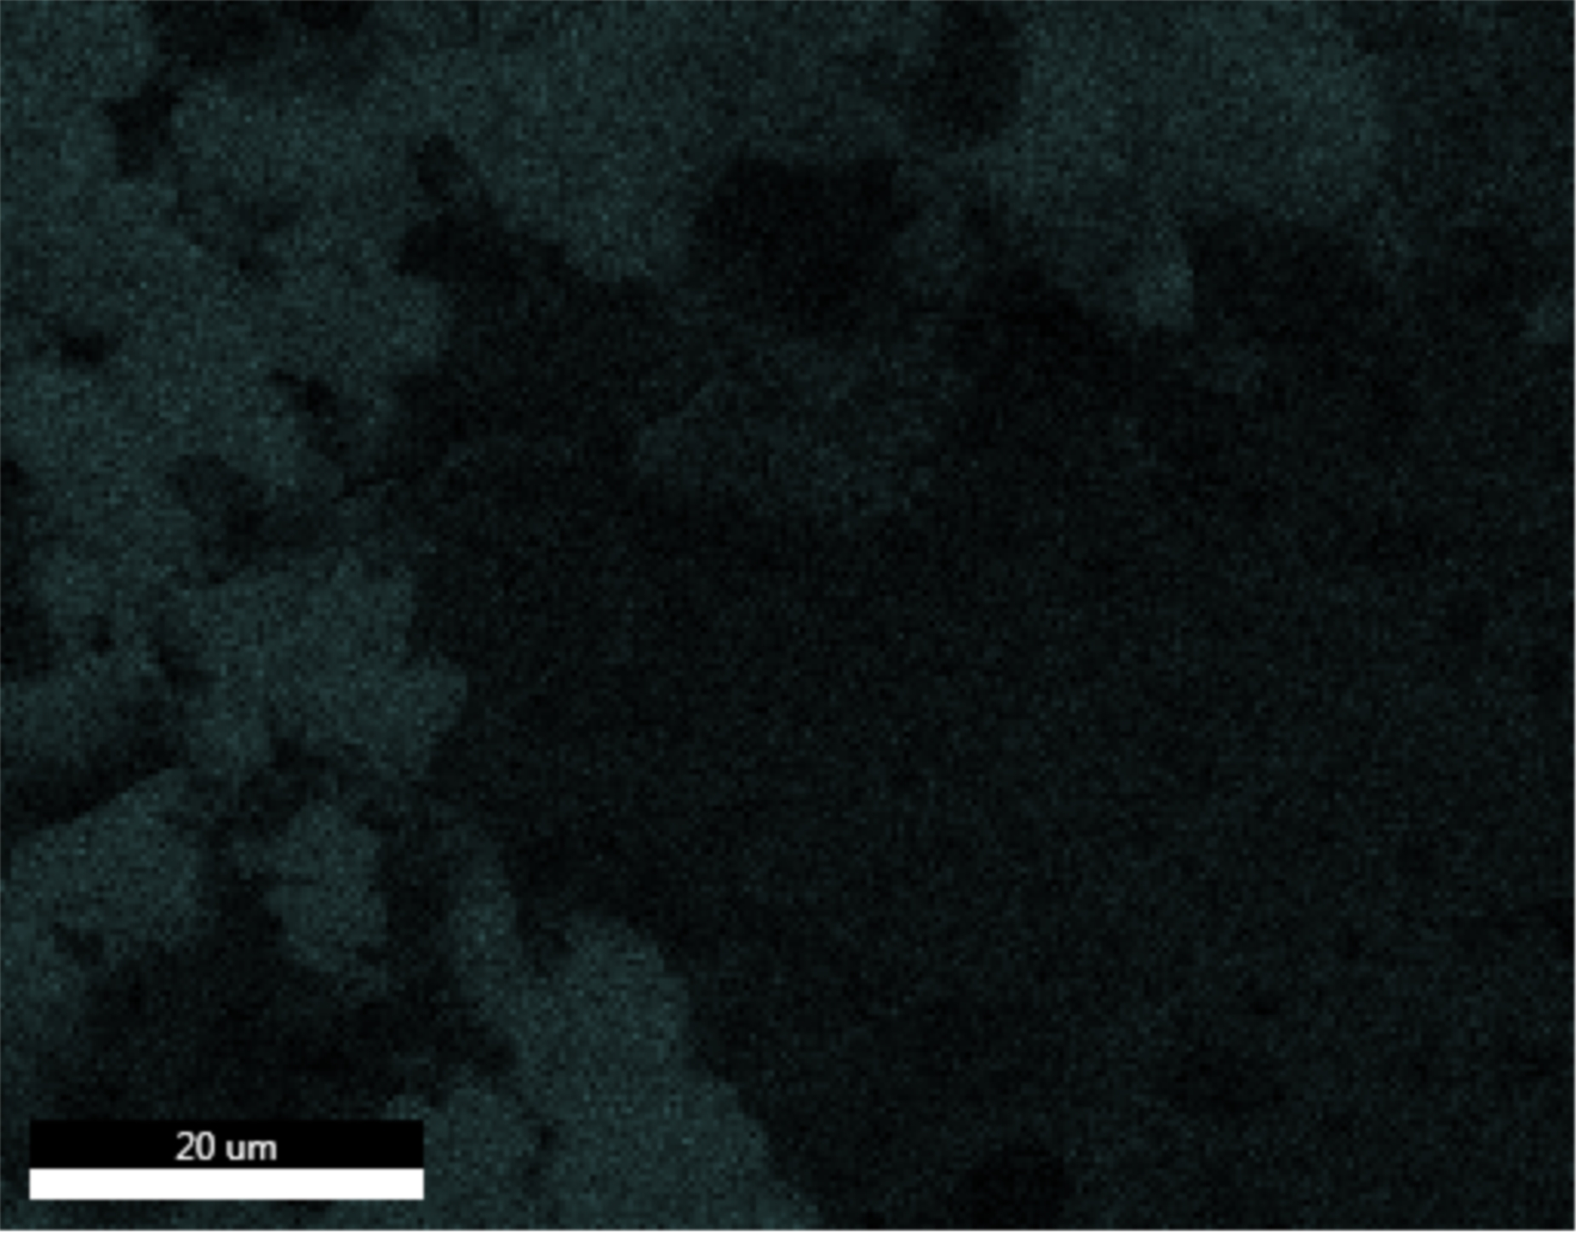
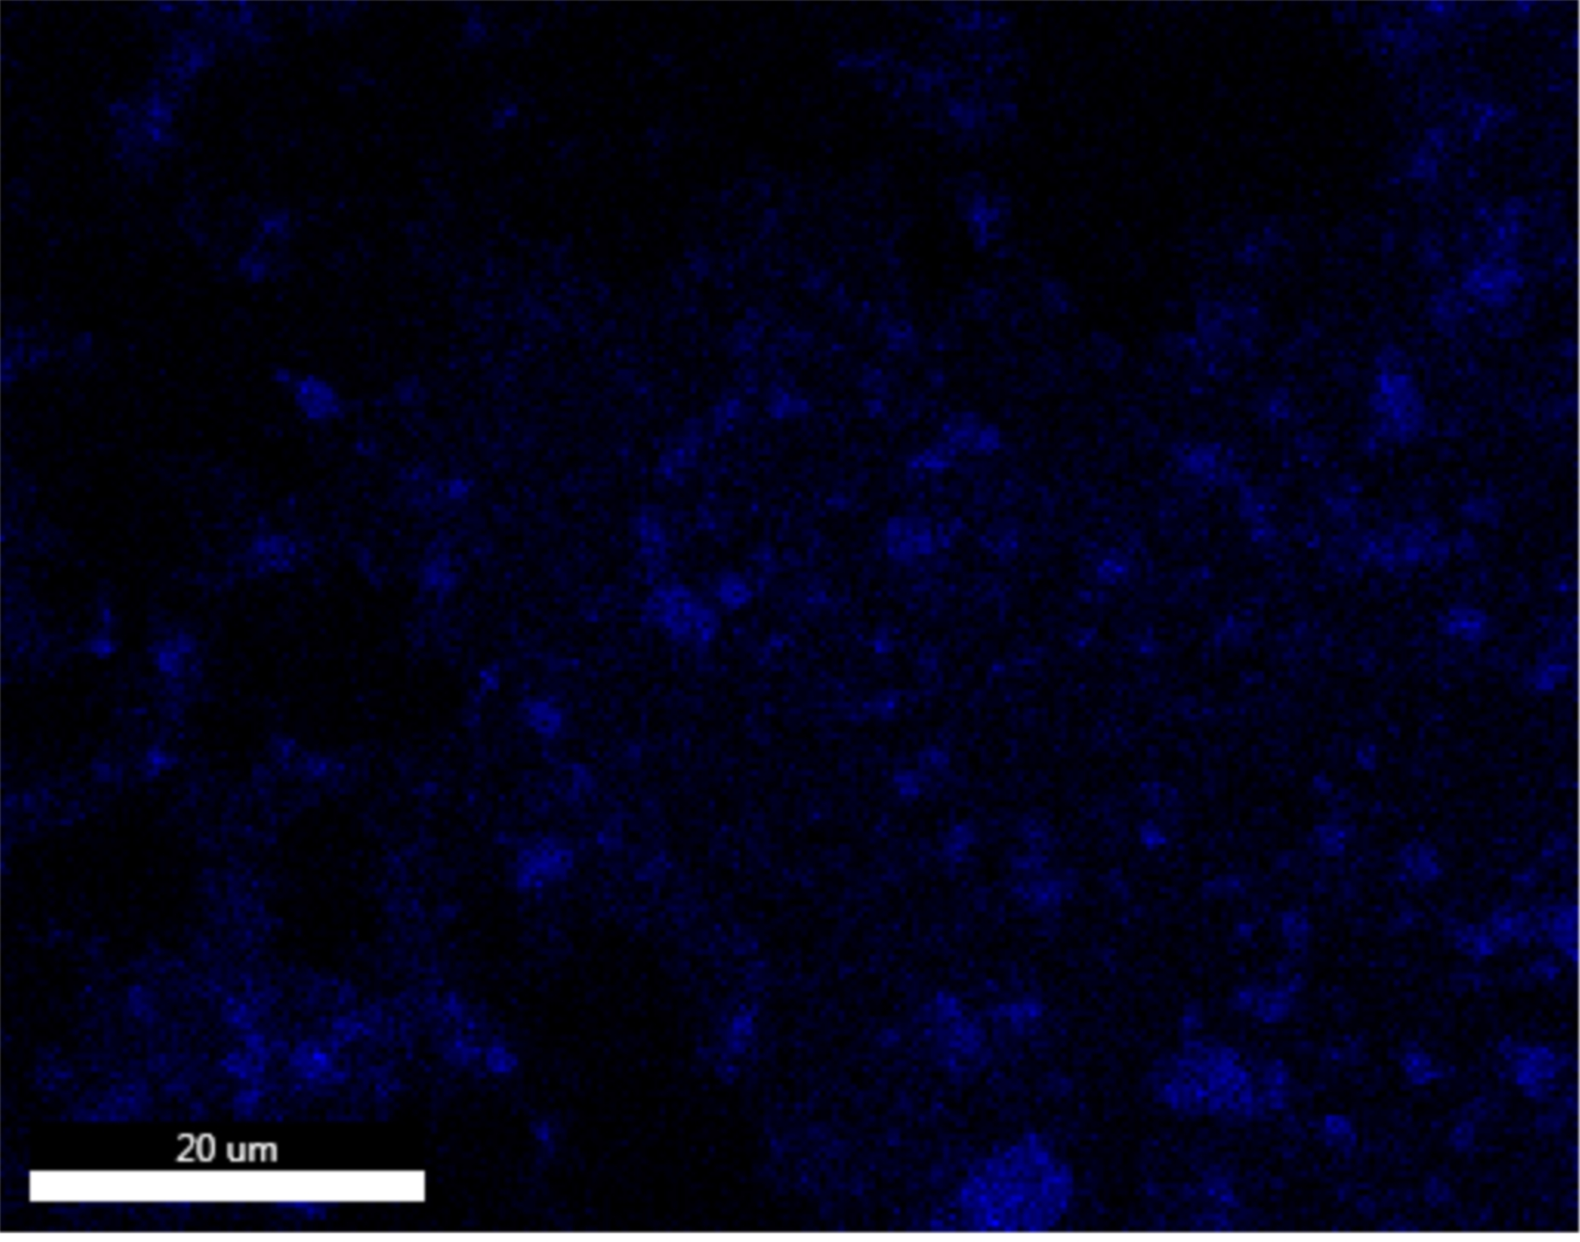
EDAX TEAM
Page
4
K K_ROI (55)
MnK_ROI (37)

Slide 5
EDAX TEAM
Page
5

